Slide 1
GPUs: Not Just for Graphics Anymore
_{David Ostrovsky | Couchbase}

Slide 2

GPGPU refers to using a Graphics Processing Unit (GPU) to perform computation in applications traditionally handled by the CPU.
Notes:
Particularly effective for Stream Processing – performing the same operation on multiple records in a stream in parallel

Slide 3
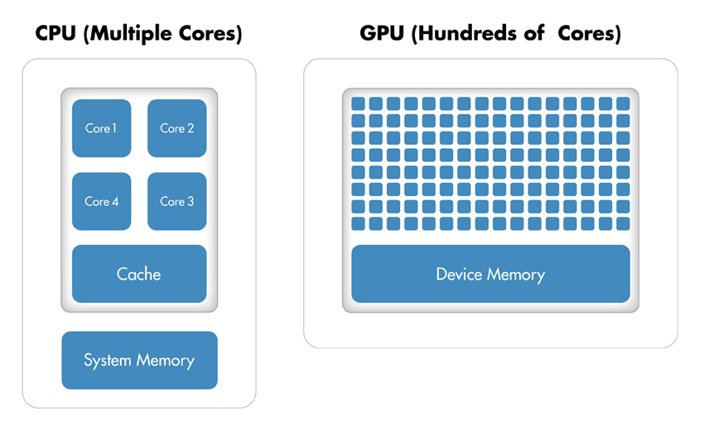
_{CPU vs. GPU Architecture}

Slide 4
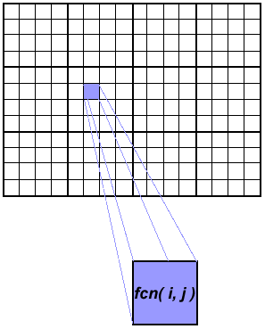
Embarrassingly Parallel Problems
Image processing, graphics rendering
Fractal images (e.g. Mandelbrot set)
String matching
Distributed queries, MapRecuce
Brute-force cryptographic attacks
Bitcoin mining
Notes:
Workloads that can be easily separated into parallel tasks. This is often the case when there is no dependency between the work units.

Slide 5
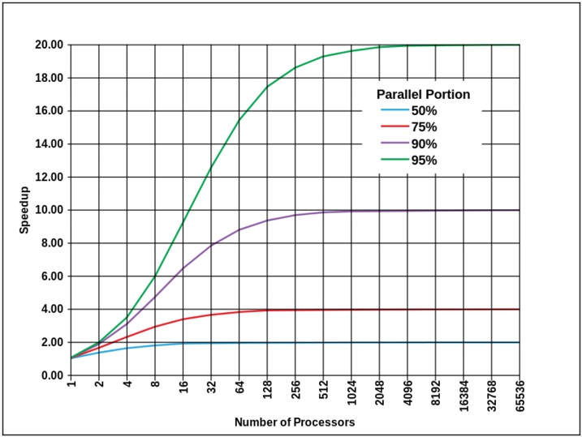
Amdahl’s Law
The speedup of a program using multiple processors in parallel computing is limited by the sequential fraction of the program.
Notes:
Gene Myron Amdahl (born November 16, 1922) is an American computer architect and high-tech entrepreneur, chiefly known for his work on mainframe computers at IBM and later his own companies, especially Amdahl Corporation. He formulated Amdahl's law, which states a fundamental limitation of parallel computing.

Slide 6
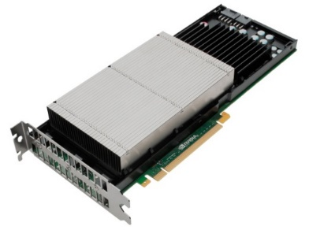
GPGPU Concepts
Texture: A common way to provide the read-only input data stream as a 2D grid.
Frame Buffer: A write-only memory interface for output.
Kernel: The operation to perform on each unit of data. Roughly similar to the body of a loop.

Slide 7
Parallelizing Your Code
Texture
Frame Buffer
void compute(float in[10000], float *out[10000])
{
for(int i=0; i < 10000; i++)
*out[i] = func(in[i]);
}
Kernel

Slide 8
GPGPU Frameworks
C++ AMP
Subset of C++
Microsoft implementation based on DirectX, integrated into Visual Studio
Supports most modern GPUs
OpenCL
Subset of C99
Implementations for Intel, AMD, and nVidia GPUs
CUDA
C++ SDK, wrappers for other languages
Only supported on nVidia GPUs

Slide 9
Client Integration
C++ AMP
Native C++ projects, P/Invoke from .NET, WinRT component, any language that can interoperate with native libraries
Supports GPU debugging, profiling
OpenCL
Vendor-specific SDKs, available from Intel, AMD, IBM, and nVidia
Wrappers for popular languages, including C#, Python, Java, etc.
Supports multiple vendor-specific debuggers

Slide 10

Using C++ AMP
Native DLL
extern "C" __declspec ( dllexport ) void _stdcall square_array(float* arr, int n)
{
array_view<float,1> dataView(n, &arr[0]);
parallel_for_each(dataView.extent, [=] (index<1> idx) restrict(amp)
{
dataView[idx] = dataView[idx] * dataView[idx];
});
dataView.synchronize();
}

Slide 11
Using C++ AMP
Managed Code
[DllImport("NativeAmpLibrary", CallingConvention = CallingConvention.StdCall)]
extern unsafe static void square_array(float* array, int length);
float[] arr = new[] { 1.0f, 2.0f, 3.0f, 4.0f };
fixed (float* arrPt = &arr[0]) {
square_array(arrPt, arr.Length);
}

Slide 12
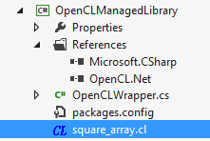
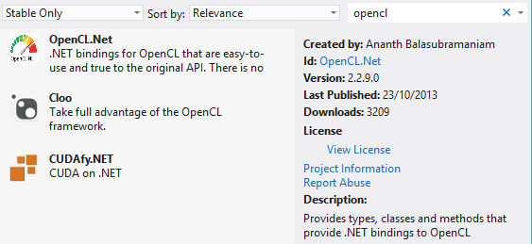
Using OpenCL
C# Project
NuGet Package

Slide 13


Using OpenCL
OpenCL Code

Slide 14
Using Aparapi (OpenCL)
Aparapi
Java Code
Converts Java bytecode to OpenCL at runtime
Syntax somewhat similar to C++ AMP
final float[] data = new float[size];
Kernel kernel = new Kernel(){
@Override public void run() {
int gid = getGlobalId();
data[gid] = data[gid] * data[gid];
}
};
kernel.execute(Range.create(512));

Slide 15
Demo Time!
Simple GPGPU Applications

Slide 16
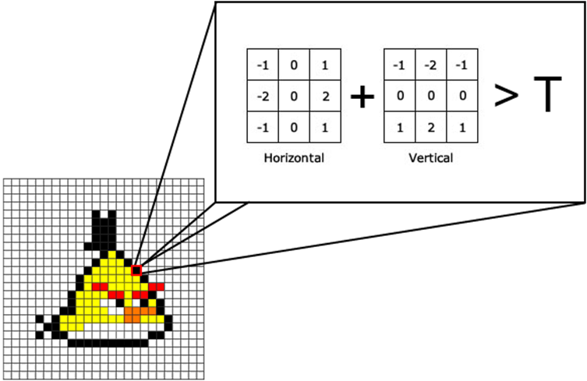
Case Study 1: Edge Detection
Sobel Operator
Find all the points in the image where the brightness changes sharply.
Pixels can be checked in parallel

Slide 17
More Demo Time!
Processing a Video Stream

Slide 18
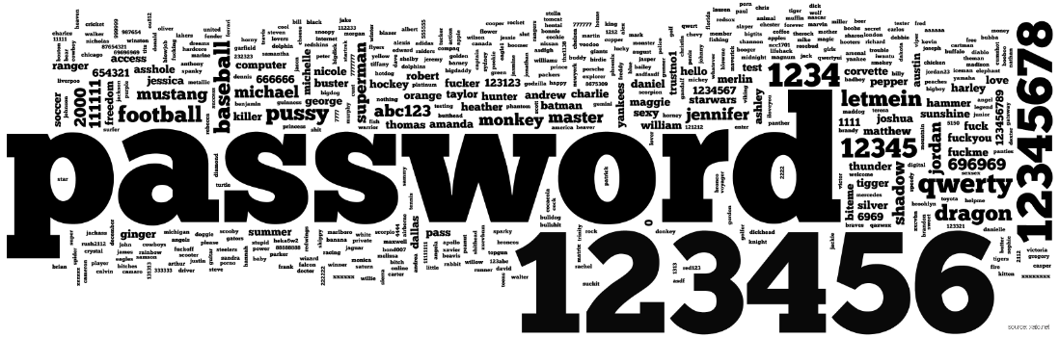
Case Study 2: Password Cracking
Passwords are commonly stored as hashes of the original plain text: "12345" = "5994471abb01112afcc18159f6cc74b4f511b99806da59b3caf5a9c173cacfc5"
Cracking a password by brute force requires repeatedly hashing guesses until a match is found – can be parallelized effectively.

Slide 19
Even More Demos!
Cracking a Single Password Hash with a Dictionary Attack

Slide 20

Notes:
Fast hash algorithms like MD5, SHA1 and SHA2 are terrible for storing passwords.
Use CPU intensive algorithms like PBKDF2, bcrypt, scrypt. They are expensive to calculate and have an adjustable work factor.

Slide 21




Thank you!
@DavidOstrovsky
CodeHardBlog.azurewebsites.net
linkedin.com/in/davidostrovsky
davido@couchbase.com
David Ostrovsky | Couchbase

